Slide 1
Workshop 2
Advanced Analytics and Applications [AAA]
Information Systems for Sustainable Society (is3) | WiSo Faculty | Univ.-Prof. Dr. Wolfgang Ketter | 4/21/21

Slide 2
I
Multiple Choice
II
Calculation
III
Programming

Slide 3
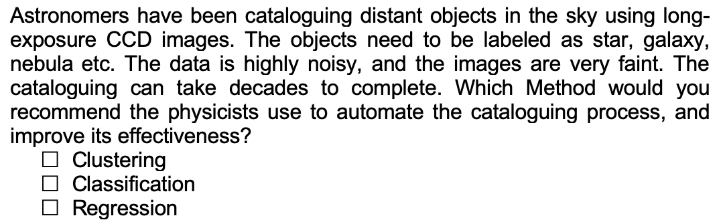
Multiple Choice Questions
Question 1:

Slide 4
Multiple Choice Questions
Question 1:

Slide 5
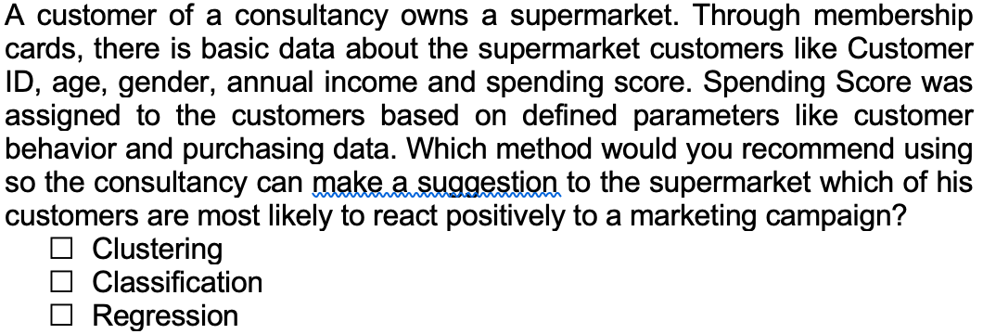
Multiple Choice Questions
Question 2:

Slide 6
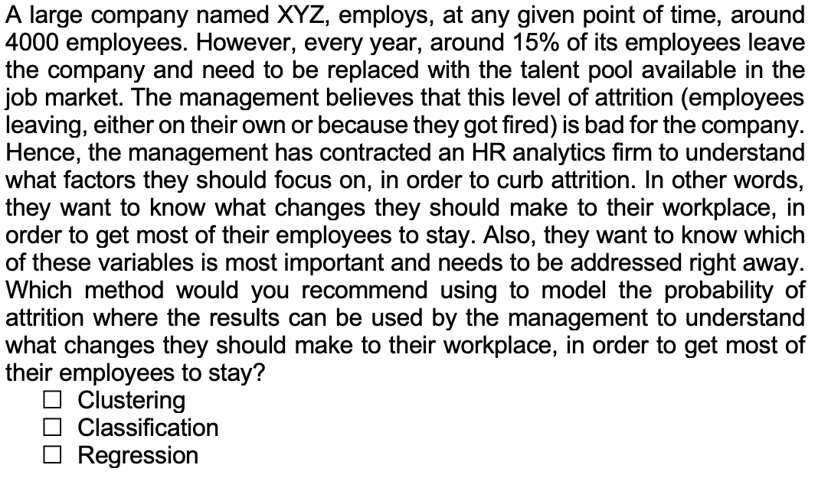
Multiple Choice Questions
Question 3:

Slide 7
Multiple Choice Questions
Question 3:

Slide 8
I
Multiple Choice
II
Calculation
III
Programming

Slide 9
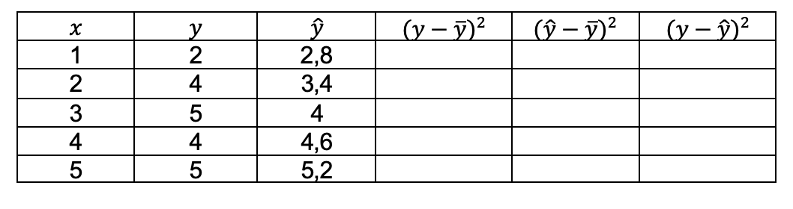
Calculation
Question 1: MSE

Slide 10
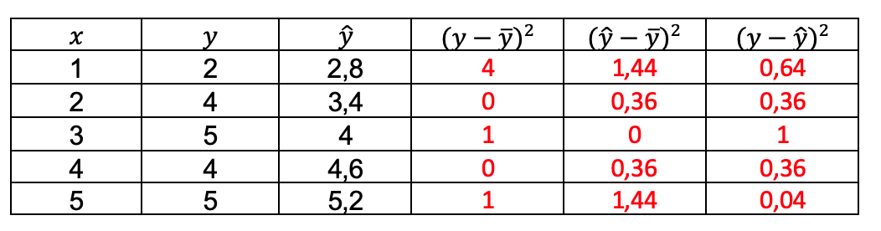
Calculation
Question 1: MSE

Slide 11
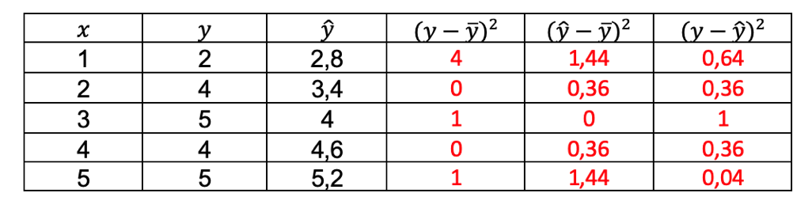
Calculation
Question 1: MSE

Slide 12

Calculation
Question 1: MSE

Slide 13
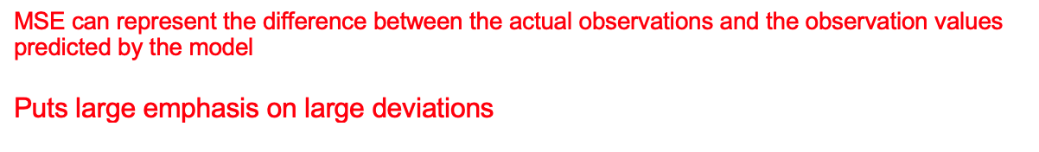
Calculation
Question 1: MSE

Slide 14
Calculation
Question 2: R^2

Slide 15
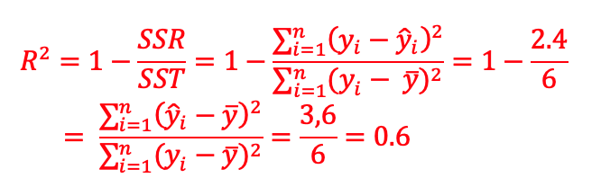
Calculation
Question 2: R^2

Slide 16
Calculation
Question 2: R^2

Slide 17
Calculation
Question 2: R^2

Slide 18
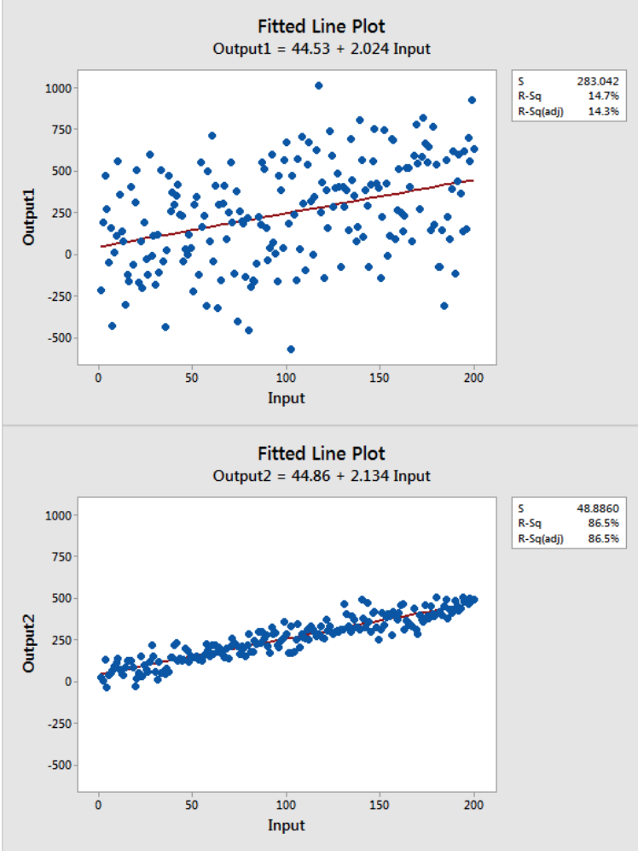
Calculation
Question 2: R^2

Slide 19
I
Multiple Choice
II
Calculation
III
Programming

Slide 20
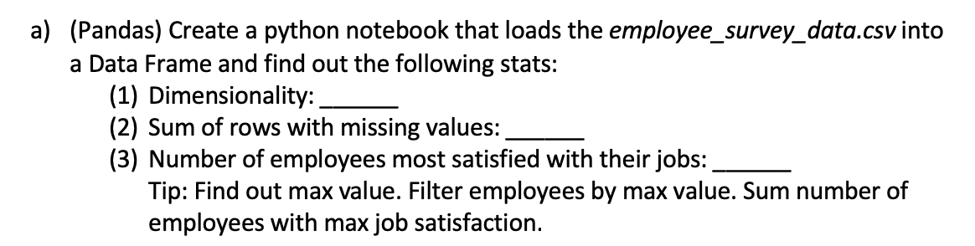
Calculation
Question 3: Working with Pandas

Slide 21
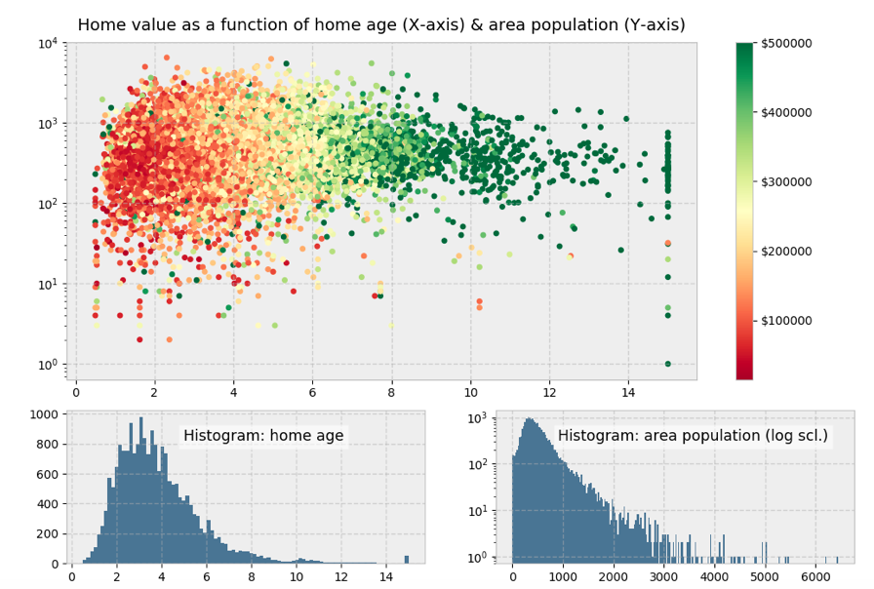
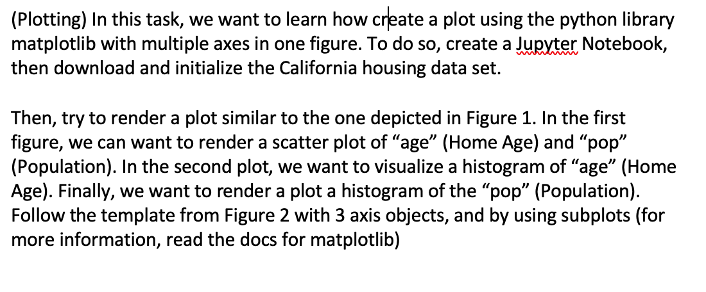
Calculation
Question 3: Plotting with MatplotLib

Slide 22
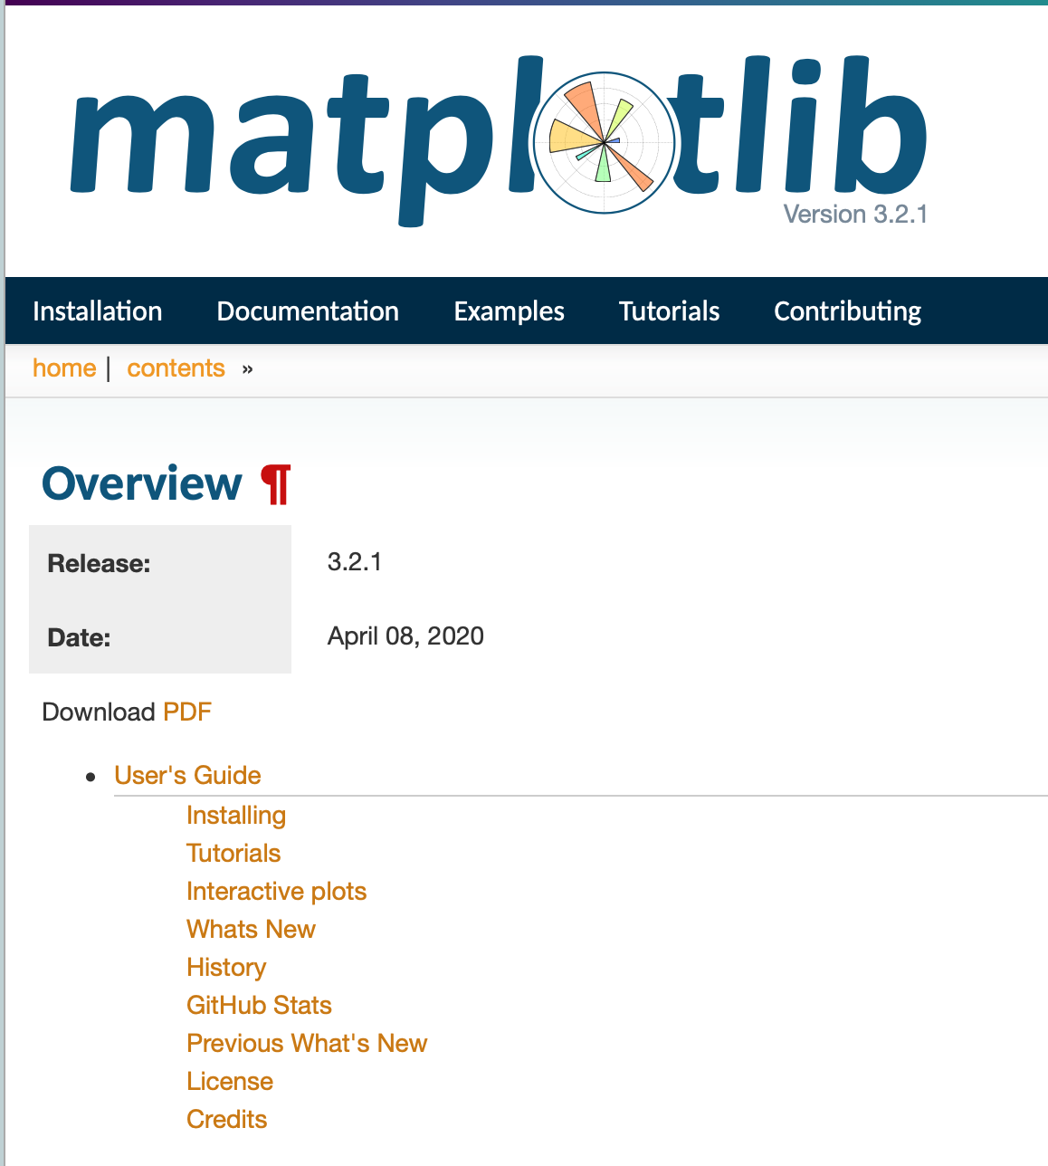
Tools
Matplotlib: Motivation for this workshop
Extensive documentation – The documentation of matplotlib is extensive and in detail BUT also hard for beginners.
Digging through the code is tedious and time-consuming (+70.000 lines).
Thus, we will cover important concept of matplotlib without commencing an "Indiana Jones" like adventure through the codebase.
Source: https://matplotlib.org/3.2.1/contents.html

Slide 23
Tools
Matplotlib: History
John D. Hunter (1968 – 2012) was an American neurobiologist and the original author of matplotlib.
Source: https://www.anaconda.com/distribution/
Notes:
Let’s start with a bit of history: John D. Hunter, a neurobiologist, began developing matplotlib around 2003, originally inspired to emulate commands from Mathworks’ MATLAB software. John passed away tragically young at age 44, in 2012, and matplotlib is now a full-fledged community effort, developed and maintained by a host of others. (John gave a talkabout the evolution of matplotlib at the 2012 SciPy conference, which is worth a watch.)

Slide 24
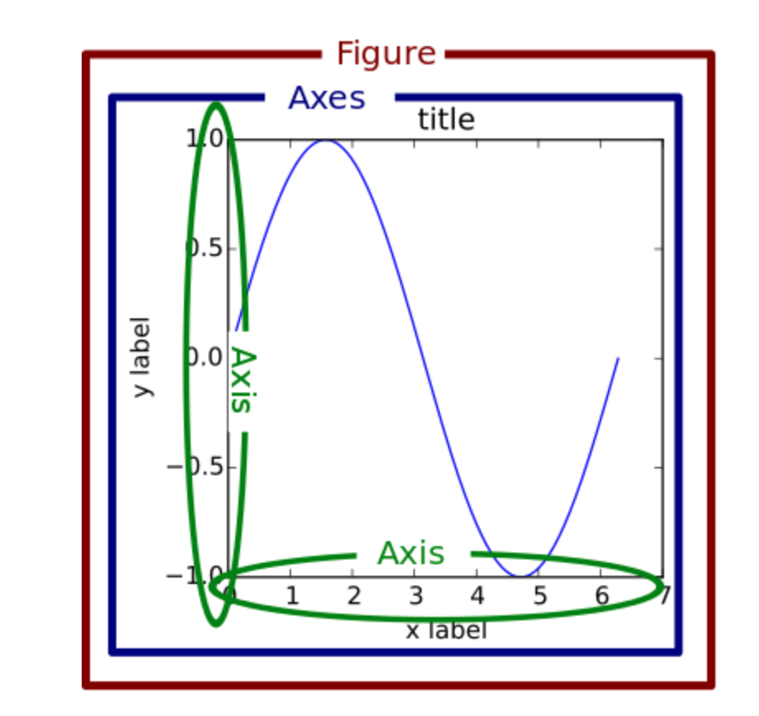
Tools
Matplotlib: The object hierarchy
plt.plot([1, 2, 3])
Create tree-like object hierarchy
Source: https://alchetron.com/John-D-Hunter /
Notes:
Let’s start with a bit of history: John D. Hunter, a neurobiologist, began developing matplotlib around 2003, originally inspired to emulate commands from Mathworks’ MATLAB software. John passed away tragically young at age 44, in 2012, and matplotlib is now a full-fledged community effort, developed and maintained by a host of others. (John gave a talkabout the evolution of matplotlib at the 2012 SciPy conference, which is worth a watch.)

Slide 25
Tools
Matplotlib: Object hierarchy under the hood
Source: https://matplotlib.org/examples/showcase/anatomy.html
Notes:
Let’s start with a bit of history: John D. Hunter, a neurobiologist, began developing matplotlib around 2003, originally inspired to emulate commands from Mathworks’ MATLAB software. John passed away tragically young at age 44, in 2012, and matplotlib is now a full-fledged community effort, developed and maintained by a host of others. (John gave a talkabout the evolution of matplotlib at the 2012 SciPy conference, which is worth a watch.)

Slide 26
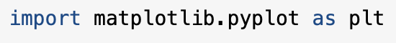
Tools
Matplotlib: Stateful versus Stateless Approach
plt.plot([1, 2, 3])
plt.title(„Hello World“)
plt.ylabels(„Emissions)
Seems like a stateful "enviroment“ but in reality it just mimics stateful behavior.
Source: https://matplotlib.org/examples/showcase/anatomy.html
Notes:
Let’s start with a bit of history: John D. Hunter, a neurobiologist, began developing matplotlib around 2003, originally inspired to emulate commands from Mathworks’ MATLAB software. John passed away tragically young at age 44, in 2012, and matplotlib is now a full-fledged community effort, developed and maintained by a host of others. (John gave a talkabout the evolution of matplotlib at the 2012 SciPy conference, which is worth a watch.)

Slide 27
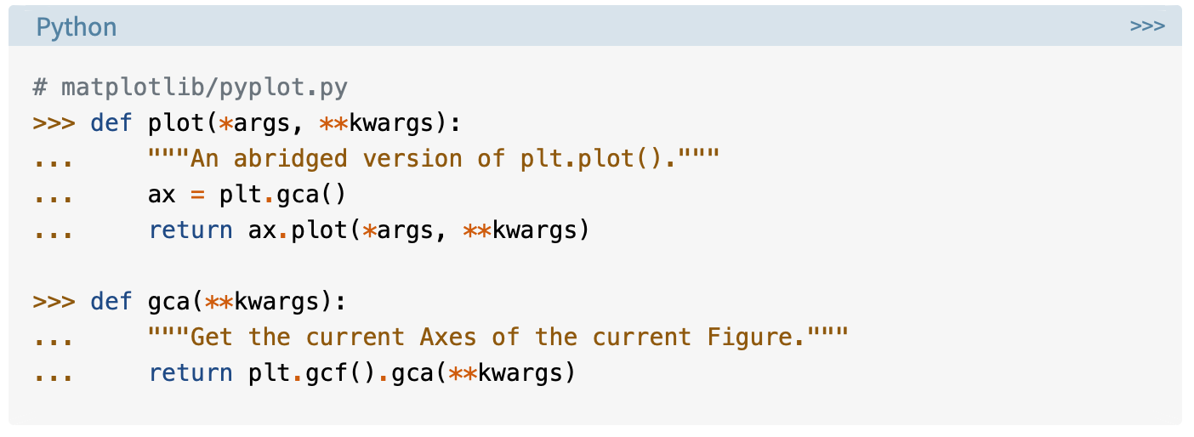
Tools
Matplotlib: Stateful versus Stateless Approach
Applies for almost any function in pyplot
https://realpython.com/python-matplotlib-guide/
Notes:
Let’s start with a bit of history: John D. Hunter, a neurobiologist, began developing matplotlib around 2003, originally inspired to emulate commands from Mathworks’ MATLAB software. John passed away tragically young at age 44, in 2012, and matplotlib is now a full-fledged community effort, developed and maintained by a host of others. (John gave a talkabout the evolution of matplotlib at the 2012 SciPy conference, which is worth a watch.)

Slide 28
Tools
Matplotlib: Stateful versus Stateless Approach
Bottom line: Matplotlib interface is object-oriented and thus is built upon the stateless approach
https://realpython.com/python-matplotlib-guide/
Notes:
Let’s start with a bit of history: John D. Hunter, a neurobiologist, began developing matplotlib around 2003, originally inspired to emulate commands from Mathworks’ MATLAB software. John passed away tragically young at age 44, in 2012, and matplotlib is now a full-fledged community effort, developed and maintained by a host of others. (John gave a talkabout the evolution of matplotlib at the 2012 SciPy conference, which is worth a watch.)

Slide 29
Contact
For general questions and enquiries on research, teaching, job openings and new projects refer to our website at www.is3.uni-koeln.de
For specific enquiries regarding this course contact us by sending an email to the IS3 teaching address at is3-teaching@wiso.uni-koeln.de

